Slide 1
Software Development with UML and Java 2

Slide 2
Agenda
Recap
Observable model
Observable properties

Slide 3
MVVM
About keeping a clean structure in your program.
You might be using it on the client side of your SEP2 project (and maybe server side)

Slide 4
Parts
View
View model
Model

Slide 5
Parts
Input validation
Presentation
Take user input
User event handling
Data
Business logic
(data manipulation)
GUI state
Data validation
Storage/
data base
Rendering
Translation
Parsing (XML, JSON)
Formatting
Networking
Here we put FXML, and View classes (called controllers in JavaFX)
Mediator between the two.
Each View has a View Model
Classes about data, rules, logic
View
View model
Model

Slide 6
Parts
Networking
Input validation
Presentation
User event handling
Storage/
data base
Data validation
Take user input
Formatting
Data
Translation
Rendering
GUI state
Business logic
(data manipulation)
Parsing (XML, JSON)
View
View model
Model

Slide 7
The View knows about the View model (reference)
The View model knows about the Model (reference)
Nothing is know the opposite way: The Model doesn’t know about the View model, and the View model knows nothing about the View.
One way dependencies
Bindings
View
View model
Model
Has a reference
Has a reference
notifications
The ViewModel updates the View through property-bindings
The Model updates the ViewModel using the observer pattern

Slide 8


Slide 9
Template UML diagram
FXML
FXML
View2
View1
ViewHandler
ViewModel2
ViewModel1
FXML
View3
ViewModel3
Application
RunApp
<<Model>>
VMProvider
DataModel

Slide 10
Template UML diagram
You should be able to follow this structure in your semester project.
View1
View2
View3
View1Ctrllr
View2Ctrllr
View3Ctrllr
JavafX::Application
ViewHandler
creates
creates
VMFactory
View1VM
View2VM
View3VM
creates
MyApplication
+ start()
creates
creates
launches
ModelFactory
creates
<<interface>> DataModel2
<<interface>> DataModel
StartApp
+ main()
DataList
DataContainer
DataLogic
LogicHelper
DataModel2Impl
DataModelImpl
DataList2
DataContainer2
DataLogic2
LogicHelper2

Slide 11


Slide 12
The Observable Model

Slide 13
Last time
Update
Update
Update
X
50
Y
30
Z
20
Bindings
TextVM
BarChartVM
PieChartVM
Model
The model may be updated from the “outside”, or just by one of our windows
X = 50%
Y = 30%
Z = 20%
External modifier

Slide 14
Update
Update
Update
X
50
Y
30
Z
20
TextVM
BarChartVM
PieChartVM
X = 50%
Y = 30%
Z = 20%
External modifier

Slide 15
Update
Update
Update
X
50
Y
30
Z
20
TextVM
BarChartVM
PieChartVM
Data has changed, but nothing happens until we manually click the Update button
X = 20%
Y = 35%
Z = 45%
External modifier

Slide 16
X
50
Y
30
Z
20
TextVM
BarChartVM
PieChartVM
X = 50%
Y = 30%
Z = 20%
External modifier
Adding observer pattern

Slide 17
X
50
Y
30
Z
20
TextVM
BarChartVM
PieChartVM
X = 50%
Y = 30%
Z = 20%
External modifier
Adding observer pattern

Slide 18
X
50
Y
30
Z
20
TextVM
BarChartVM
PieChartVM
X = 20%
Y = 45%
Z = 35%
External modifier
Adding observer pattern

Slide 19
X
20
Y
45
Z
35
TextVM
BarChartVM
PieChartVM
X = 20%
Y = 45%
Z = 35%
External modifier
Adding observer pattern

Slide 20
X
20
Y
45
Z
35
TextVM
BarChartVM
PieChartVM
Adding observer pattern
X = 20%
Y = 45%
Z = 35%
External modifier

Slide 21


Slide 22
Code Example
FXML
PieChartController
Here we use the PropertyChange-Listener
PieChartVM
Here we use the PropertyChangeSupport to make the model a Subject
<<interface>> DataModel
DataModelImpl

Slide 23
Code Example
FXML
PieChartController
PieChartVM
<<interface>> DataModel
DataModelImpl

Slide 24
Code Example
How do we make the Model observable?
FXML
PieChartController
PieChartVM
<<interface>> DataModel
DataModelImpl

Slide 25
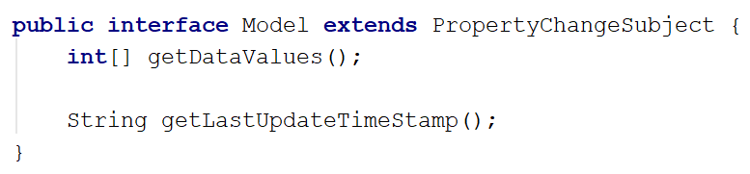
How many interfaces can I extend?
How do we make the Model observable?
Code Example
FXML
PieChartController
PieChartVM
<<interface>> PropertyChangeSubject
+ addListener(listener : PropertyChangeListener) : void …. (more methods)
Our PropertyChangeSubject interface from previous session
<<interface>> DataModel
What other methods did we have?
DataModelImpl

Slide 26
What needs to change in the DataModelImpl??
Code Example
FXML
PieChartController
PieChartVM
<<interface>> PropertyChangeSubject
+ addListener(listener : PropertyChangeListener) : void …. (more methods)
<<interface>> DataModel
DataModelImpl

Slide 27
public class DataModel implements Model { private int x; private int y; private int z; private String lastUpdate; private Random random = new Random(); private PropertyChangeSupport changeSupport = new PropertyChangeSupport(this); @Override public int[] getDataValues() { return new int[]{x, y, z}; } @Override public String getLastUpdateTimeStamp() { return lastUpdate; } public void recalculateData() { int first = random.nextInt(100)+1; int second = random.nextInt(100)+1; int bottom = Math.min(first, second); int top = Math.max(first, second); x = bottom; y = top - bottom; z = 100 - top; changeSupport.firePropertyChange("Data", null, new int[]{x, y, z}); calTimeStamp(); } private void calTimeStamp() { SimpleDateFormat sdfDate = new SimpleDateFormat("HH:mm:ss"); Date now = new Date(); String strDate = sdfDate.format(now); System.out.println(strDate); changeSupport.firePropertyChange("TimeUpdate", lastUpdate, strDate); lastUpdate = strDate; } @Override public void addPropertyChangeListener(String name, PropertyChangeListener listener) { if(name == null) changeSupport.addPropertyChangeListener(listener); else changeSupport.addPropertyChangeListener(name, listener); } @Override public void addPropertyChangeListener(PropertyChangeListener listener) { changeSupport.addPropertyChangeListener(listener); } @Override public void removePropertyChangeListener(String name, PropertyChangeListener listener) { if(name == null) changeSupport.removePropertyChangeListener(listener); else changeSupport.removePropertyChangeListener(name, listener); } @Override public void removePropertyChangeListener(PropertyChangeListener listener) { changeSupport.removePropertyChangeListener(listener); } }
Code Example
FXML
PieChartController
What’s this? How does it work?
PieChartVM
<<interface>> PropertyChangeSubject
+ addListener(listener : PropertyChangeListener) : void …. (more methods)
<<interface>> DataModel
DataModelImpl

Slide 28
public class DataModel implements Model { private int x; private int y; private int z; private String lastUpdate; private Random random = new Random(); private PropertyChangeSupport changeSupport = new PropertyChangeSupport(this); @Override public int[] getDataValues() { return new int[]{x, y, z}; } @Override public String getLastUpdateTimeStamp() { return lastUpdate; } public void recalculateData() { int first = random.nextInt(100)+1; int second = random.nextInt(100)+1; int bottom = Math.min(first, second); int top = Math.max(first, second); x = bottom; y = top - bottom; z = 100 - top; changeSupport.firePropertyChange("Data", null, new int[]{x, y, z}); calTimeStamp(); } private void calTimeStamp() { SimpleDateFormat sdfDate = new SimpleDateFormat("HH:mm:ss"); Date now = new Date(); String strDate = sdfDate.format(now); System.out.println(strDate); changeSupport.firePropertyChange("TimeUpdate", lastUpdate, strDate); lastUpdate = strDate; } @Override public void addPropertyChangeListener(String name, PropertyChangeListener listener) { if(name == null) changeSupport.addPropertyChangeListener(listener); else changeSupport.addPropertyChangeListener(name, listener); } @Override public void addPropertyChangeListener(PropertyChangeListener listener) { changeSupport.addPropertyChangeListener(listener); } @Override public void removePropertyChangeListener(String name, PropertyChangeListener listener) { if(name == null) changeSupport.removePropertyChangeListener(listener); else changeSupport.removePropertyChangeListener(name, listener); } @Override public void removePropertyChangeListener(PropertyChangeListener listener) { changeSupport.removePropertyChangeListener(listener); } }
Code Example
Could give array of old values
FXML
PieChartController
What happens here?
PieChartVM
<<interface>> PropertyChangeSubject
+ addListener(listener : PropertyChangeListener) : void …. (more methods)
<<interface>> DataModel
DataModelImpl

Slide 29
public class DataModel implements Model { private int x; private int y; private int z; private String lastUpdate; private Random random = new Random(); private PropertyChangeSupport changeSupport = new PropertyChangeSupport(this); @Override public int[] getDataValues() { return new int[]{x, y, z}; } @Override public String getLastUpdateTimeStamp() { return lastUpdate; } public void recalculateData() { int first = random.nextInt(100)+1; int second = random.nextInt(100)+1; int bottom = Math.min(first, second); int top = Math.max(first, second); x = bottom; y = top - bottom; z = 100 - top; changeSupport.firePropertyChange("Data", null, new int[]{x, y, z}); calTimeStamp(); } private void calTimeStamp() { SimpleDateFormat sdfDate = new SimpleDateFormat("HH:mm:ss"); Date now = new Date(); String strDate = sdfDate.format(now); System.out.println(strDate); changeSupport.firePropertyChange("TimeUpdate", lastUpdate, strDate); lastUpdate = strDate; } @Override public void addPropertyChangeListener(String name, PropertyChangeListener listener) { if(name == null) changeSupport.addPropertyChangeListener(listener); else changeSupport.addPropertyChangeListener(name, listener); } @Override public void addPropertyChangeListener(PropertyChangeListener listener) { changeSupport.addPropertyChangeListener(listener); } @Override public void removePropertyChangeListener(String name, PropertyChangeListener listener) { if(name == null) changeSupport.removePropertyChangeListener(listener); else changeSupport.removePropertyChangeListener(name, listener); } @Override public void removePropertyChangeListener(PropertyChangeListener listener) { changeSupport.removePropertyChangeListener(listener); } }
Code Example
FXML
PieChartController
What does this method do?
PieChartVM
<<interface>> PropertyChangeSubject
+ addListener(listener : PropertyChangeListener) : void …. (more methods)
<<interface>> DataModel
DataModelImpl

Slide 30
How do we add listeners?
Code Example
FXML
Is interested in what changes in the model
PieChartController
PieChartVM
<<interface>> PropertyChangeSubject
+ addListener(listener : PropertyChangeListener) : void …. (more methods)
<<interface>> DataModel
DataModelImpl

Slide 31
public class PieChartViewModel { private DoubleProperty x; private DoubleProperty y; private DoubleProperty z; private StringProperty updateTimeStamp; private Model model; public PieChartViewModel(Model model) { this.model = model; x = new SimpleDoubleProperty(); y = new SimpleDoubleProperty(); z = new SimpleDoubleProperty(); updateTimeStamp = new SimpleStringProperty("Last update: "); model.addPropertyChangeListener("Data", evt -> updatePieChart(evt)); model.addPropertyChangeListener("TimeUpdate", evt -> timeStampUpdated(evt)); } public void updatePieChart(PropertyChangeEvent evt) { Platform.runLater(() -> { int[] vals = (int[]) evt.getNewValue(); x.setValue(vals[0]); y.setValue(vals[1]); z.setValue(vals[2]); }); } private void timeStampUpdated(PropertyChangeEvent evt) { Platform.runLater(() -> { updateTimeStamp.setValue("Last updated: " + evt.getNewValue()); }); }
Code Example
What are these?
FXML
PieChartController
What am I doing here?
PieChartVM
<<interface>> PropertyChangeSubject
+ addListener(listener : PropertyChangeListener) : void …. (more methods)
<<interface>> DataModel
DataModelImpl

Slide 32
public class PieChartViewModel { private DoubleProperty x; private DoubleProperty y; private DoubleProperty z; private StringProperty updateTimeStamp; private Model model; public PieChartViewModel(Model model) { this.model = model; x = new SimpleDoubleProperty(); y = new SimpleDoubleProperty(); z = new SimpleDoubleProperty(); updateTimeStamp = new SimpleStringProperty("Last update: "); model.addPropertyChangeListener("Data", evt -> updatePieChart(evt)); model.addPropertyChangeListener("TimeUpdate", evt -> timeStampUpdated(evt)); } public void updatePieChart(PropertyChangeEvent evt) { Platform.runLater(() -> { int[] vals = (int[]) evt.getNewValue(); x.setValue(vals[0]); y.setValue(vals[1]); z.setValue(vals[2]); }); } private void timeStampUpdated(PropertyChangeEvent evt) { Platform.runLater(() -> { updateTimeStamp.setValue("Last updated: " + evt.getNewValue()); }); }
Code Example
FXML
PieChartController
What happens when these are updated?
<<interface>> PropertyChangeSubject
+ addListener(listener : PropertyChangeListener) : void …. (more methods)
PieChartVM
Notice the Platform.runLater
<<interface>> DataModel
DataModelImpl

Slide 33
public class PieChartViewModel { private DoubleProperty x; private DoubleProperty y; private DoubleProperty z; private StringProperty updateTimeStamp; private Model model; public PieChartViewModel(Model model) { this.model = model; x = new SimpleDoubleProperty(); y = new SimpleDoubleProperty(); z = new SimpleDoubleProperty(); updateTimeStamp = new SimpleStringProperty("Last update: "); model.addPropertyChangeListener("Data", evt -> updatePieChart(evt)); model.addPropertyChangeListener("TimeUpdate", evt -> timeStampUpdated(evt)); } public void updatePieChart(PropertyChangeEvent evt) { Platform.runLater(() -> { int[] vals = (int[]) evt.getNewValue(); x.setValue(vals[0]); y.setValue(vals[1]); z.setValue(vals[2]); }); } private void timeStampUpdated(PropertyChangeEvent evt) { Platform.runLater(() -> { updateTimeStamp.setValue("Last updated: " + evt.getNewValue()); }); }
Code Example
FXML
PieChartController
PieChartVM
<<interface>> PropertyChangeSubject
+ addListener(listener : PropertyChangeListener) : void …. (more methods)
Notice the Platform.runLater
<<interface>> DataModel
What happens when this is updated?
DataModelImpl

Slide 34


Slide 35
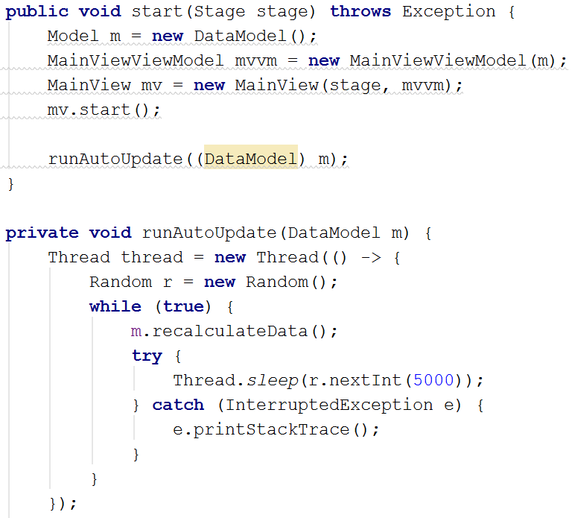
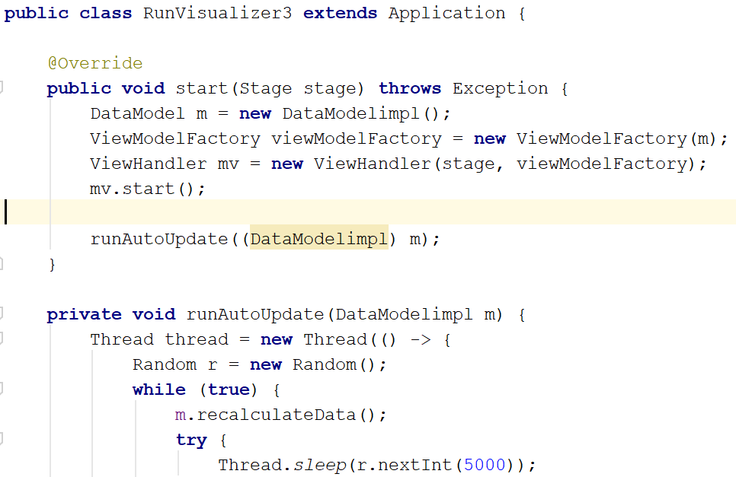
Why Platform.runLater ??
public class DataModel implements Model { private int x; private int y; private int z; private String lastUpdate; private Random random = new Random(); private PropertyChangeSupport changeSupport = new PropertyChangeSupport(this); @Override public int[] getDataValues() { return new int[]{x, y, z}; } @Override public String getLastUpdateTimeStamp() { return lastUpdate; } @Override public void addListener(String name, PropertyChangeListener listener) { if(name == null) changeSupport.addPropertyChangeListener(listener); else changeSupport.addPropertyChangeListener(name, listener); } public void recalculateData() { int first = random.nextInt(100)+1; int second = random.nextInt(100)+1; int bottom = Math.min(first, second); int top = Math.max(first, second); x = bottom; y = top - bottom; z = 100 - top; System.out.println("1: " + x); System.out.println("2: " + y); System.out.println("3: " + z); System.out.println("Sum: " + (x + y + z)); changeSupport.firePropertyChange("Data", null, new int[]{x, y, z}); calTimeStamp(); } private void calTimeStamp() { SimpleDateFormat sdfDate = new SimpleDateFormat("HH:mm:ss"); Date now = new Date(); String strDate = sdfDate.format(now); System.out.println(strDate); changeSupport.firePropertyChange("TimeUpdate", lastUpdate, strDate); lastUpdate = strDate; } }
public class PieChartViewModel { private DoubleProperty x; private DoubleProperty y; private DoubleProperty z; private StringProperty updateTimeStamp; private Model model; public PieChartViewModel(Model model) { this.model = model; x = new SimpleDoubleProperty(); y = new SimpleDoubleProperty(); z = new SimpleDoubleProperty(); updateTimeStamp = new SimpleStringProperty("Last update: "); model.addListener("Data", evt -> updatePieChart(evt)); model.addListener("TimeUpdate", evt -> timeStampUpdated(evt)); } public void updatePieChart(PropertyChangeEvent evt) { Platform.runLater(() -> { int[] vals = (int[]) evt.getNewValue(); x.setValue(vals[0]); y.setValue(vals[1]); z.setValue(vals[2]); }); } private void timeStampUpdated(PropertyChangeEvent evt) { Platform.runLater(() -> { updateTimeStamp.setValue("Last updated: " + evt.getNewValue()); }); }
The start method started the JavaFX application
It also started another thread to update the model
Only JavaFX threads can update JavaFX Properties.
What’s this?

Slide 36
Why Platform.runLater ??
public class DataModel implements Model { private int x; private int y; private int z; private String lastUpdate; private Random random = new Random(); private PropertyChangeSupport changeSupport = new PropertyChangeSupport(this); @Override public int[] getDataValues() { return new int[]{x, y, z}; } @Override public String getLastUpdateTimeStamp() { return lastUpdate; } @Override public void addListener(String name, PropertyChangeListener listener) { if(name == null) changeSupport.addPropertyChangeListener(listener); else changeSupport.addPropertyChangeListener(name, listener); } public void recalculateData() { int first = random.nextInt(100)+1; int second = random.nextInt(100)+1; int bottom = Math.min(first, second); int top = Math.max(first, second); x = bottom; y = top - bottom; z = 100 - top; System.out.println("1: " + x); System.out.println("2: " + y); System.out.println("3: " + z); System.out.println("Sum: " + (x + y + z)); changeSupport.firePropertyChange("Data", null, new int[]{x, y, z}); calTimeStamp(); } private void calTimeStamp() { SimpleDateFormat sdfDate = new SimpleDateFormat("HH:mm:ss"); Date now = new Date(); String strDate = sdfDate.format(now); System.out.println(strDate); changeSupport.firePropertyChange("TimeUpdate", lastUpdate, strDate); lastUpdate = strDate; } }
public class PieChartViewModel { private DoubleProperty x; private DoubleProperty y; private DoubleProperty z; private StringProperty updateTimeStamp; private Model model; public PieChartViewModel(Model model) { this.model = model; x = new SimpleDoubleProperty(); y = new SimpleDoubleProperty(); z = new SimpleDoubleProperty(); updateTimeStamp = new SimpleStringProperty("Last update: "); model.addListener("Data", evt -> updatePieChart(evt)); model.addListener("TimeUpdate", evt -> timeStampUpdated(evt)); } public void updatePieChart(PropertyChangeEvent evt) { Platform.runLater(() -> { int[] vals = (int[]) evt.getNewValue(); x.setValue(vals[0]); y.setValue(vals[1]); z.setValue(vals[2]); }); } private void timeStampUpdated(PropertyChangeEvent evt) { Platform.runLater(() -> { updateTimeStamp.setValue("Last updated: " + evt.getNewValue()); }); }
The start method started the JavaFX application
It also started another thread to update the model
Tegn uml på tavlen
Only JavaFX threads can update JavaFX Properties.

Slide 37
Why Platform.runLater ??
public class DataModel implements Model { private int x; private int y; private int z; private String lastUpdate; private Random random = new Random(); private PropertyChangeSupport changeSupport = new PropertyChangeSupport(this); @Override public int[] getDataValues() { return new int[]{x, y, z}; } @Override public String getLastUpdateTimeStamp() { return lastUpdate; } @Override public void addListener(String name, PropertyChangeListener listener) { if(name == null) changeSupport.addPropertyChangeListener(listener); else changeSupport.addPropertyChangeListener(name, listener); } public void recalculateData() { int first = random.nextInt(100)+1; int second = random.nextInt(100)+1; int bottom = Math.min(first, second); int top = Math.max(first, second); x = bottom; y = top - bottom; z = 100 - top; System.out.println("1: " + x); System.out.println("2: " + y); System.out.println("3: " + z); System.out.println("Sum: " + (x + y + z)); changeSupport.firePropertyChange("Data", null, new int[]{x, y, z}); calTimeStamp(); } private void calTimeStamp() { SimpleDateFormat sdfDate = new SimpleDateFormat("HH:mm:ss"); Date now = new Date(); String strDate = sdfDate.format(now); System.out.println(strDate); changeSupport.firePropertyChange("TimeUpdate", lastUpdate, strDate); lastUpdate = strDate; } }
public class PieChartViewModel { private DoubleProperty x; private DoubleProperty y; private DoubleProperty z; private StringProperty updateTimeStamp; private Model model; public PieChartViewModel(Model model) { this.model = model; x = new SimpleDoubleProperty(); y = new SimpleDoubleProperty(); z = new SimpleDoubleProperty(); updateTimeStamp = new SimpleStringProperty("Last update: "); model.addListener("Data", evt -> updatePieChart(evt)); model.addListener("TimeUpdate", evt -> timeStampUpdated(evt)); } public void updatePieChart(PropertyChangeEvent evt) { Platform.runLater(() -> { int[] vals = (int[]) evt.getNewValue(); x.setValue(vals[0]); y.setValue(vals[1]); z.setValue(vals[2]); }); } private void timeStampUpdated(PropertyChangeEvent evt) { Platform.runLater(() -> { updateTimeStamp.setValue("Last updated: " + evt.getNewValue()); }); }
The start method started the JavaFX application
It also started another thread to update the model
Only JavaFX threads can update JavaFX Properties.

Slide 38
Why Platform.runLater ??
public class DataModel implements Model { private int x; private int y; private int z; private String lastUpdate; private Random random = new Random(); private PropertyChangeSupport changeSupport = new PropertyChangeSupport(this); @Override public int[] getDataValues() { return new int[]{x, y, z}; } @Override public String getLastUpdateTimeStamp() { return lastUpdate; } @Override public void addListener(String name, PropertyChangeListener listener) { if(name == null) changeSupport.addPropertyChangeListener(listener); else changeSupport.addPropertyChangeListener(name, listener); } public void recalculateData() { int first = random.nextInt(100)+1; int second = random.nextInt(100)+1; int bottom = Math.min(first, second); int top = Math.max(first, second); x = bottom; y = top - bottom; z = 100 - top; System.out.println("1: " + x); System.out.println("2: " + y); System.out.println("3: " + z); System.out.println("Sum: " + (x + y + z)); changeSupport.firePropertyChange("Data", null, new int[]{x, y, z}); calTimeStamp(); } private void calTimeStamp() { SimpleDateFormat sdfDate = new SimpleDateFormat("HH:mm:ss"); Date now = new Date(); String strDate = sdfDate.format(now); System.out.println(strDate); changeSupport.firePropertyChange("TimeUpdate", lastUpdate, strDate); lastUpdate = strDate; } }
public class PieChartViewModel { private DoubleProperty x; private DoubleProperty y; private DoubleProperty z; private StringProperty updateTimeStamp; private Model model; public PieChartViewModel(Model model) { this.model = model; x = new SimpleDoubleProperty(); y = new SimpleDoubleProperty(); z = new SimpleDoubleProperty(); updateTimeStamp = new SimpleStringProperty("Last update: "); model.addListener("Data", evt -> updatePieChart(evt)); model.addListener("TimeUpdate", evt -> timeStampUpdated(evt)); } public void updatePieChart(PropertyChangeEvent evt) { Platform.runLater(() -> { int[] vals = (int[]) evt.getNewValue(); x.setValue(vals[0]); y.setValue(vals[1]); z.setValue(vals[2]); }); } private void timeStampUpdated(PropertyChangeEvent evt) { Platform.runLater(() -> { updateTimeStamp.setValue("Last updated: " + evt.getNewValue()); }); }
Model
The start method started the JavaFX application
It also started another thread to update the model
Only JavaFX threads can update JavaFX Properties.

Slide 39
Why Platform.runLater ??
public class DataModel implements Model { private int x; private int y; private int z; private String lastUpdate; private Random random = new Random(); private PropertyChangeSupport changeSupport = new PropertyChangeSupport(this); @Override public int[] getDataValues() { return new int[]{x, y, z}; } @Override public String getLastUpdateTimeStamp() { return lastUpdate; } @Override public void addListener(String name, PropertyChangeListener listener) { if(name == null) changeSupport.addPropertyChangeListener(listener); else changeSupport.addPropertyChangeListener(name, listener); } public void recalculateData() { int first = random.nextInt(100)+1; int second = random.nextInt(100)+1; int bottom = Math.min(first, second); int top = Math.max(first, second); x = bottom; y = top - bottom; z = 100 - top; System.out.println("1: " + x); System.out.println("2: " + y); System.out.println("3: " + z); System.out.println("Sum: " + (x + y + z)); changeSupport.firePropertyChange("Data", null, new int[]{x, y, z}); calTimeStamp(); } private void calTimeStamp() { SimpleDateFormat sdfDate = new SimpleDateFormat("HH:mm:ss"); Date now = new Date(); String strDate = sdfDate.format(now); System.out.println(strDate); changeSupport.firePropertyChange("TimeUpdate", lastUpdate, strDate); lastUpdate = strDate; } }
public class PieChartViewModel { private DoubleProperty x; private DoubleProperty y; private DoubleProperty z; private StringProperty updateTimeStamp; private Model model; public PieChartViewModel(Model model) { this.model = model; x = new SimpleDoubleProperty(); y = new SimpleDoubleProperty(); z = new SimpleDoubleProperty(); updateTimeStamp = new SimpleStringProperty("Last update: "); model.addListener("Data", evt -> updatePieChart(evt)); model.addListener("TimeUpdate", evt -> timeStampUpdated(evt)); } public void updatePieChart(PropertyChangeEvent evt) { Platform.runLater(() -> { int[] vals = (int[]) evt.getNewValue(); x.setValue(vals[0]); y.setValue(vals[1]); z.setValue(vals[2]); }); } private void timeStampUpdated(PropertyChangeEvent evt) { Platform.runLater(() -> { updateTimeStamp.setValue("Last updated: " + evt.getNewValue()); }); }
The start method started the JavaFX application
It also started another thread to update the model
Only JavaFX threads can update JavaFX Properties.

Slide 40
Why Platform.runLater ??
public class DataModel implements Model { private int x; private int y; private int z; private String lastUpdate; private Random random = new Random(); private PropertyChangeSupport changeSupport = new PropertyChangeSupport(this); @Override public int[] getDataValues() { return new int[]{x, y, z}; } @Override public String getLastUpdateTimeStamp() { return lastUpdate; } @Override public void addListener(String name, PropertyChangeListener listener) { if(name == null) changeSupport.addPropertyChangeListener(listener); else changeSupport.addPropertyChangeListener(name, listener); } public void recalculateData() { int first = random.nextInt(100)+1; int second = random.nextInt(100)+1; int bottom = Math.min(first, second); int top = Math.max(first, second); x = bottom; y = top - bottom; z = 100 - top; System.out.println("1: " + x); System.out.println("2: " + y); System.out.println("3: " + z); System.out.println("Sum: " + (x + y + z)); changeSupport.firePropertyChange("Data", null, new int[]{x, y, z}); calTimeStamp(); } private void calTimeStamp() { SimpleDateFormat sdfDate = new SimpleDateFormat("HH:mm:ss"); Date now = new Date(); String strDate = sdfDate.format(now); System.out.println(strDate); changeSupport.firePropertyChange("TimeUpdate", lastUpdate, strDate); lastUpdate = strDate; } }
public class PieChartViewModel { private DoubleProperty x; private DoubleProperty y; private DoubleProperty z; private StringProperty updateTimeStamp; private Model model; public PieChartViewModel(Model model) { this.model = model; x = new SimpleDoubleProperty(); y = new SimpleDoubleProperty(); z = new SimpleDoubleProperty(); updateTimeStamp = new SimpleStringProperty("Last update: "); model.addListener("Data", evt -> updatePieChart(evt)); model.addListener("TimeUpdate", evt -> timeStampUpdated(evt)); } public void updatePieChart(PropertyChangeEvent evt) { Platform.runLater(() -> { int[] vals = (int[]) evt.getNewValue(); x.setValue(vals[0]); y.setValue(vals[1]); z.setValue(vals[2]); }); } private void timeStampUpdated(PropertyChangeEvent evt) { Platform.runLater(() -> { updateTimeStamp.setValue("Last updated: " + evt.getNewValue()); }); }
The start method started the JavaFX application
It also started another thread to update the model
Only JavaFX threads can update JavaFX Properties.

Slide 41
Why Platform.runLater ??
public class DataModel implements Model { private int x; private int y; private int z; private String lastUpdate; private Random random = new Random(); private PropertyChangeSupport changeSupport = new PropertyChangeSupport(this); @Override public int[] getDataValues() { return new int[]{x, y, z}; } @Override public String getLastUpdateTimeStamp() { return lastUpdate; } @Override public void addListener(String name, PropertyChangeListener listener) { if(name == null) changeSupport.addPropertyChangeListener(listener); else changeSupport.addPropertyChangeListener(name, listener); } public void recalculateData() { int first = random.nextInt(100)+1; int second = random.nextInt(100)+1; int bottom = Math.min(first, second); int top = Math.max(first, second); x = bottom; y = top - bottom; z = 100 - top; System.out.println("1: " + x); System.out.println("2: " + y); System.out.println("3: " + z); System.out.println("Sum: " + (x + y + z)); changeSupport.firePropertyChange("Data", null, new int[]{x, y, z}); calTimeStamp(); } private void calTimeStamp() { SimpleDateFormat sdfDate = new SimpleDateFormat("HH:mm:ss"); Date now = new Date(); String strDate = sdfDate.format(now); System.out.println(strDate); changeSupport.firePropertyChange("TimeUpdate", lastUpdate, strDate); lastUpdate = strDate; } }
public class PieChartViewModel { private DoubleProperty x; private DoubleProperty y; private DoubleProperty z; private StringProperty updateTimeStamp; private Model model; public PieChartViewModel(Model model) { this.model = model; x = new SimpleDoubleProperty(); y = new SimpleDoubleProperty(); z = new SimpleDoubleProperty(); updateTimeStamp = new SimpleStringProperty("Last update: "); model.addListener("Data", evt -> updatePieChart(evt)); model.addListener("TimeUpdate", evt -> timeStampUpdated(evt)); } public void updatePieChart(PropertyChangeEvent evt) { Platform.runLater(() -> { int[] vals = (int[]) evt.getNewValue(); x.setValue(vals[0]); y.setValue(vals[1]); z.setValue(vals[2]); }); } private void timeStampUpdated(PropertyChangeEvent evt) { Platform.runLater(() -> { updateTimeStamp.setValue("Last updated: " + evt.getNewValue()); }); }
A non-JavaFX thread attempts to update properties
The start method started the JavaFX application
It also started another thread to update the model
We must wrap the property updates in the Platform.runLater
Only JavaFX threads can update JavaFX Properties.

Slide 42
Why Platform.runLater ??
So whenever a non-JavaFX thread attempts to update properties, we must wrap it in a Platform.runLater
You’ll encounter a similar problem, when data from a Server is pushed to the Client, which then updates the model…

Slide 43


Slide 44
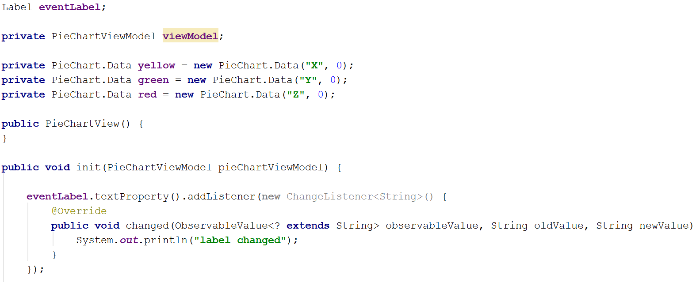
Listening for property changes
Properties can be bound together, so when one property is modified, another property will automatically reflect this.
You can also add listeners to properties:

Slide 45
Listening for property changes
Properties can be bound together, so when one property is modified, another property will automatically reflect this.
You can also add listeners to properties:
Add the ChangeListener to the property

Slide 46
Listening for property changes
Properties can be bound together, so when one property is modified, another property will automatically reflect this.
You can also add listeners to properties:
The property it-self

Slide 47
Listening for property changes
Properties can be bound together, so when one property is modified, another property will automatically reflect this.
You can also add listeners to properties:
Old and new values

Slide 48
Listening for property changes
Properties can be bound together, so when one property is modified, another property will automatically reflect this.
You can also add listeners to properties:
Put your code here

Slide 49


Slide 50
About the assignment
Next Tuesday, we’ll talk about MVVM and networking
At 11:30 I’ll present the assignment.
Next Friday (the 4th), you work on the assignment in class, no new topics.
The following Tuesday (the 8th) is also dedicated to the assignment.
Primary deadline on the 8th (moved one day forward)

Slide 51
About the exercise solution videos
They diverge a little from the theory in the slides.
The videos are from last semester, and we modified a few minor things in our MVVM theory.
Mostly just naming conventions

Slide 52
About today’s exercises

Slide 53
Anyone here?

Slide 54


